Slide 1
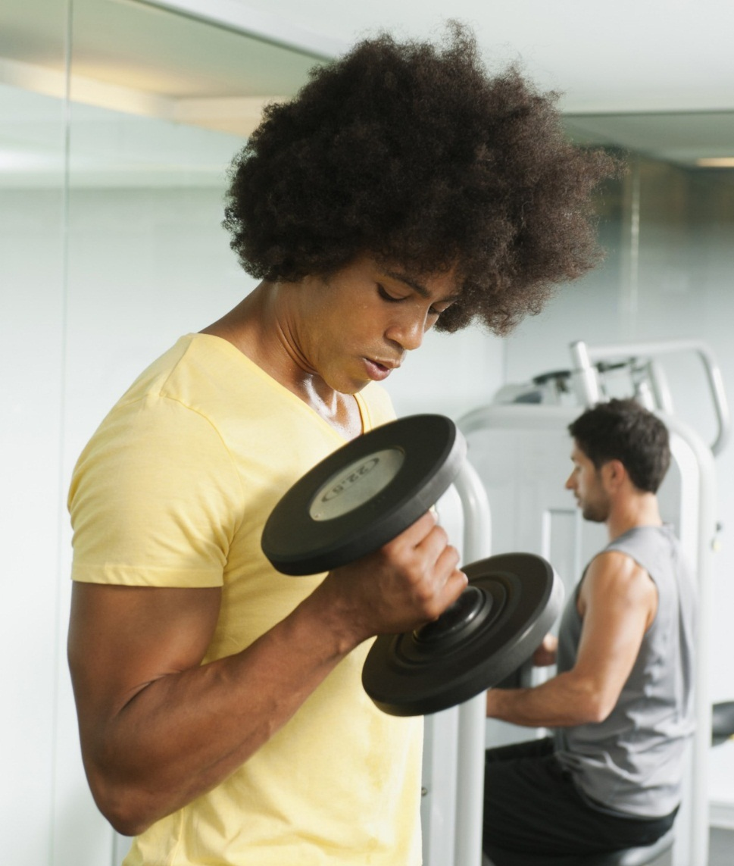
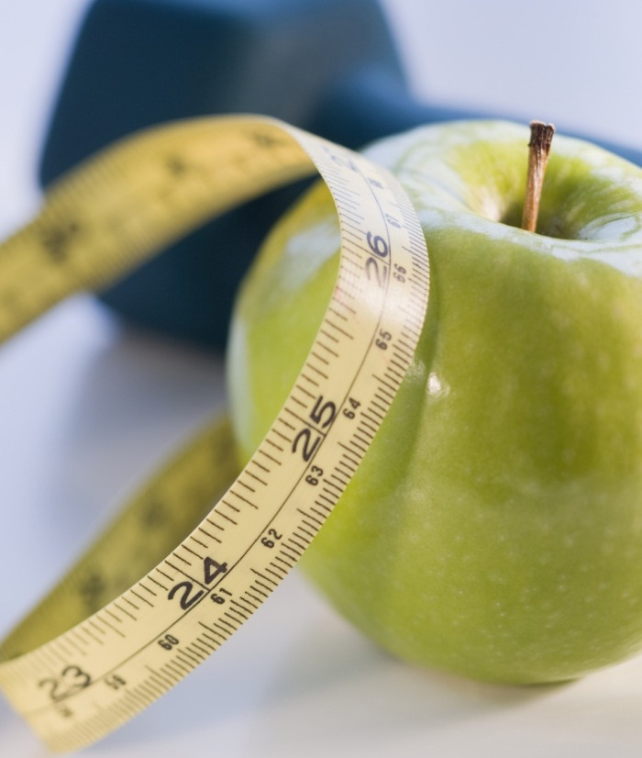
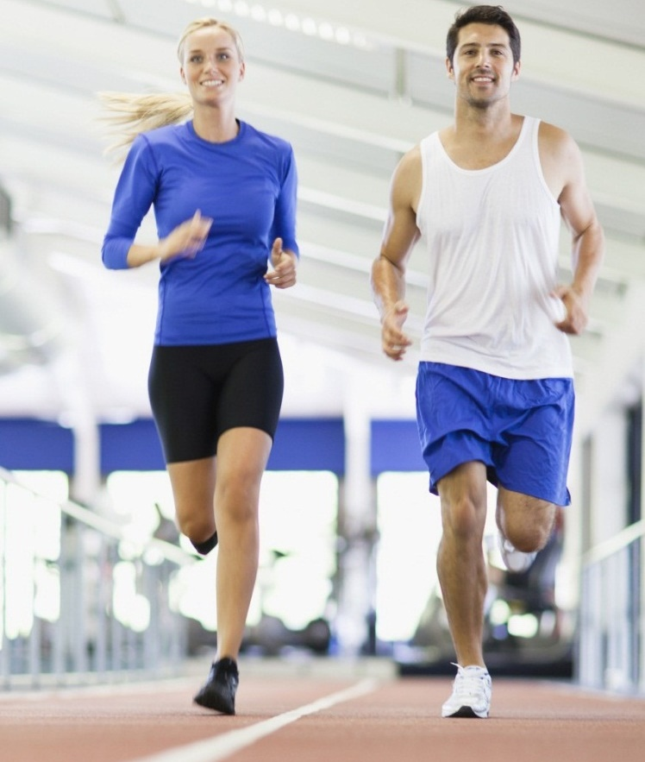
Analyzing my health & fitness data
Aman chopra

Slide 2
Content overview
Background
Dataset & Pipeline
EDA
Analysis (model building, diagnosis, validation)
Applications and Conclusion

Slide 3
background

Slide 4


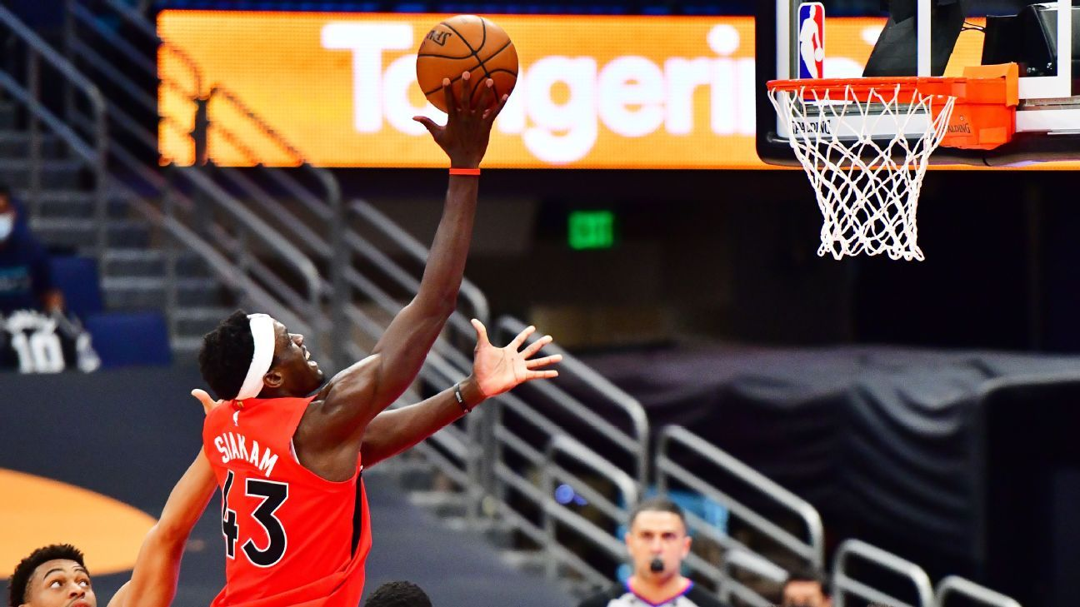
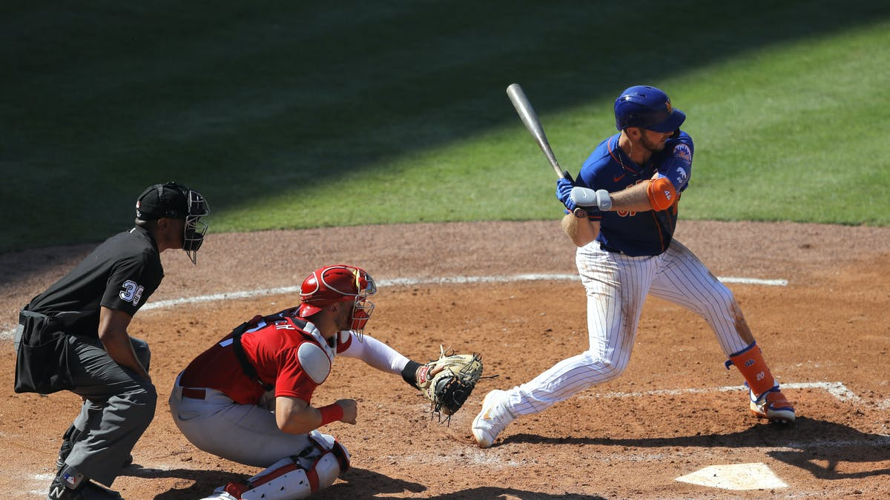
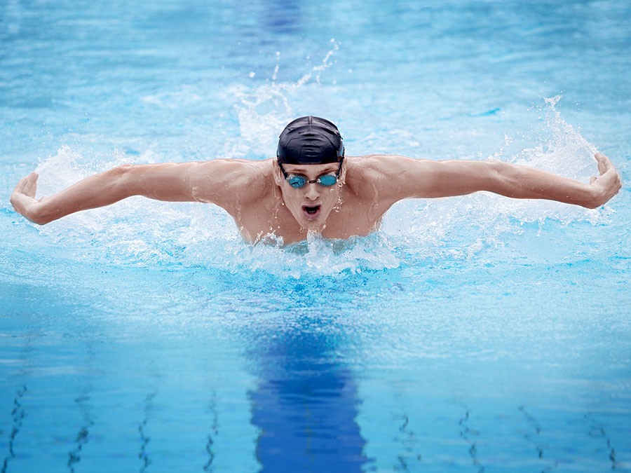
SPORTS AND NUTRITION HAVE ALWAYS BEEN A LARGE COMPONENT IN MY LIFE.
Notes:
Since my childhood, I’ve always been into a variety of sports. I started off with baseball and swimming and then moved onto hiking, which I did through Boyscouts, and then basketball which I played recreationally in high school. In sophomore yr of college, I started to get more serious about nutrition and finding foods that give my consistent energy and make me feel satiated. After covid hit last year, I decided to go a step further and bought an apple watch to help log my fitness and nutrition. I started tracking calories, micro & macro nutrients, workout intensity, heart rate, steps, and much more.

Slide 5
Dataset
Notes:
Now, lets dive a bit more into the dataset that I constructed.

Slide 6
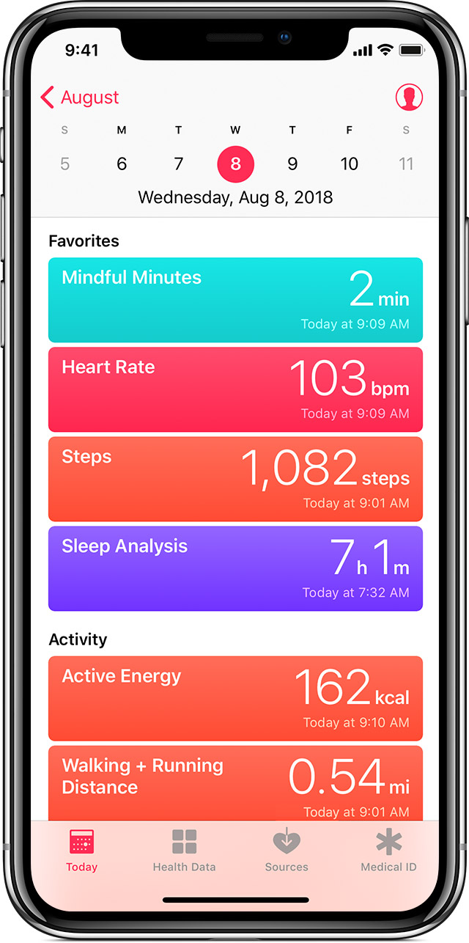
Apple health
Body Fat Percentage
Body Mass
BMI
Walking & Running Distance
Flights Climbed
Lean Body Mass
Step Count
Walking Speed
Notes:
From the apple health app on my phone, I have collected metrics like…
This has been automatically logged since I bought my current iphone in 2019.

Slide 7
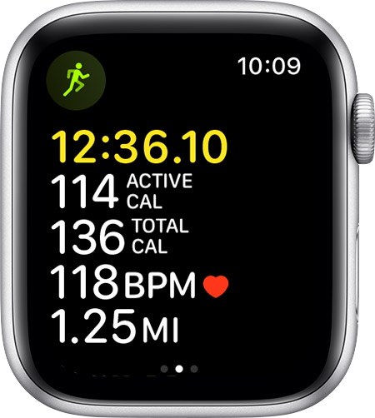
Apple watch
Active Energy Burned
Exercise Time
Stand Time
Active Heart Rate
Heart Rate Variability
Oxygen Saturation
Resting Heart Rate
Total Energy Burned
Notes:
From my apple watch, which I purchased last yr during COVID, I started being able to track more workout-related measures like how many calroies I burn a day, exercise time, ….
I wear my apple watch constantly through the day, except when I shower and sleep, so the data is quite high frequency.

Slide 8
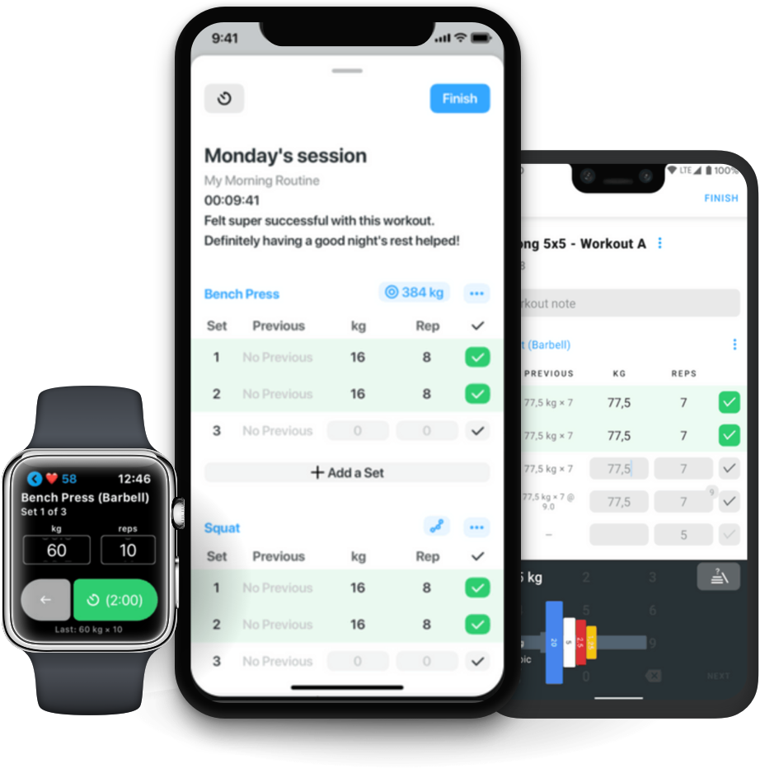
strong
Number of Workouts
Workout Duration
Rate of Perceived Exertion (RPE)
Notes:
In the past yr, I started using the Strong app on my iphone to track the number of workouts I have per day, the durations, and how I perceive the intensity of each workout, which is known as RPE.

Slide 9
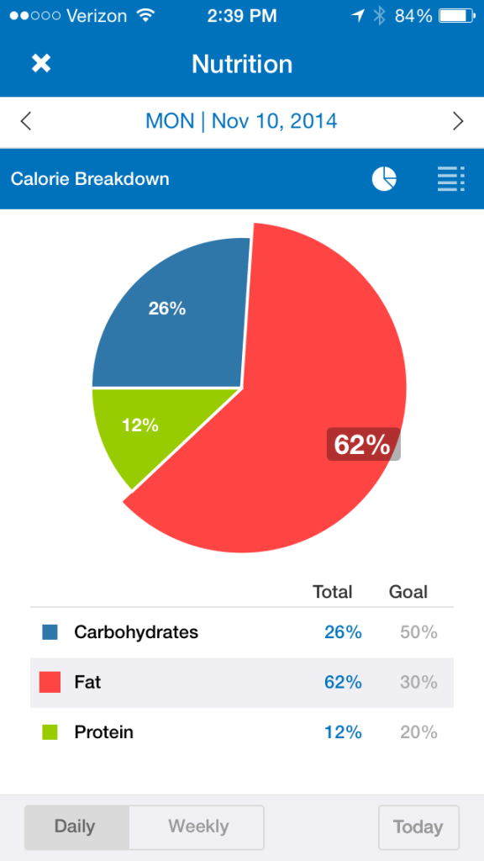
myfitnesspal
Calories
Carbs
Fat
Protein
Sodium
Sugar
Notes:
Lastly, since last year, ive been using MFP to track calories and other macro and micronutrients.
I have been quite consistent with tracking and only have msised a handful of days.

Slide 10
pipeline
ETL
Preprocessing and Feature Engineering
Analytics
Notes:
Now, lets dive into the pipeline of this project. I first started by extracting, transforming, laoding, and merging the data in python. Then I continued with preprocessing and feature engineering, which included imputation and other steps. Lastly, I ended with the analytics which well dive to in this presentation.

Slide 11
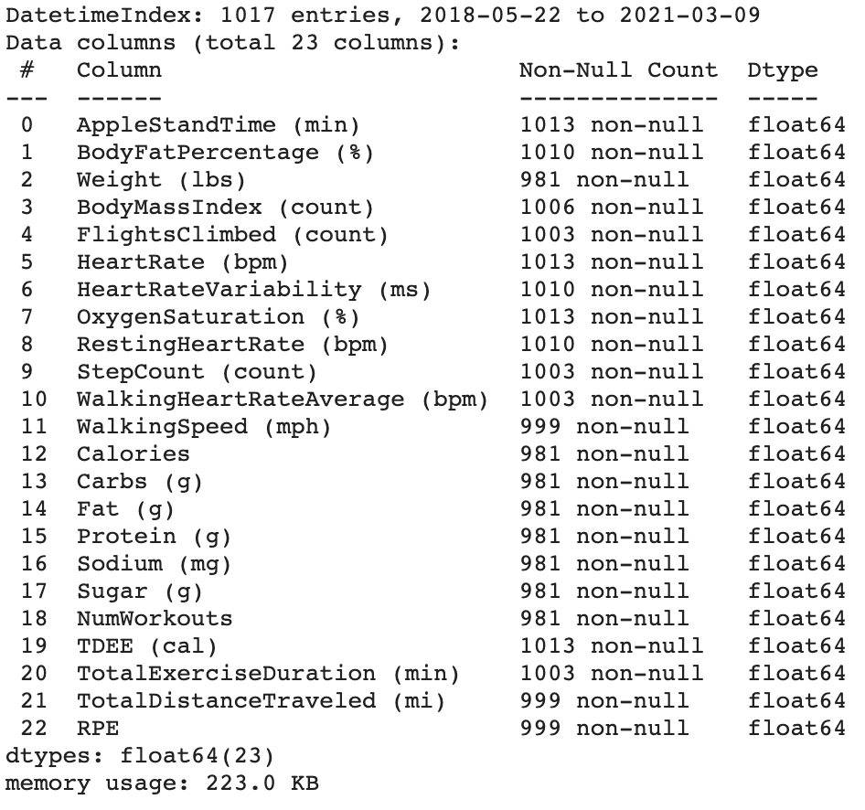
Final dataset
Constructed pivot tables for each data source.
Aggregated by the day.
681 records & 22 features after dropping rows with missing values.
Notes:
The final dataset was aggregated by each day, resulting in 681 records and 22 features.

Slide 12
eda
Notes:
When analyzing the data, I first wanted to get an overview of the features, distributions, and relationships between variables.

Slide 13
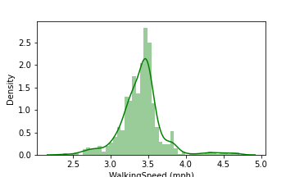
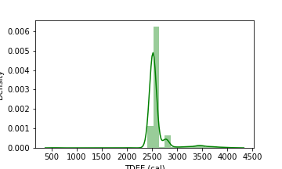
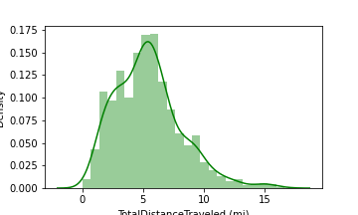
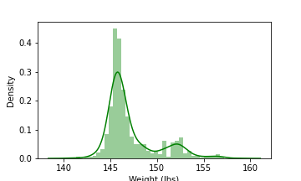
Distributions
Notes:
Here are some of the distributions, most of them seem normally distributed, but others appear bimodal or skewed. As we will see when constructing models, these could play a role when performing diagnostics.

Slide 14
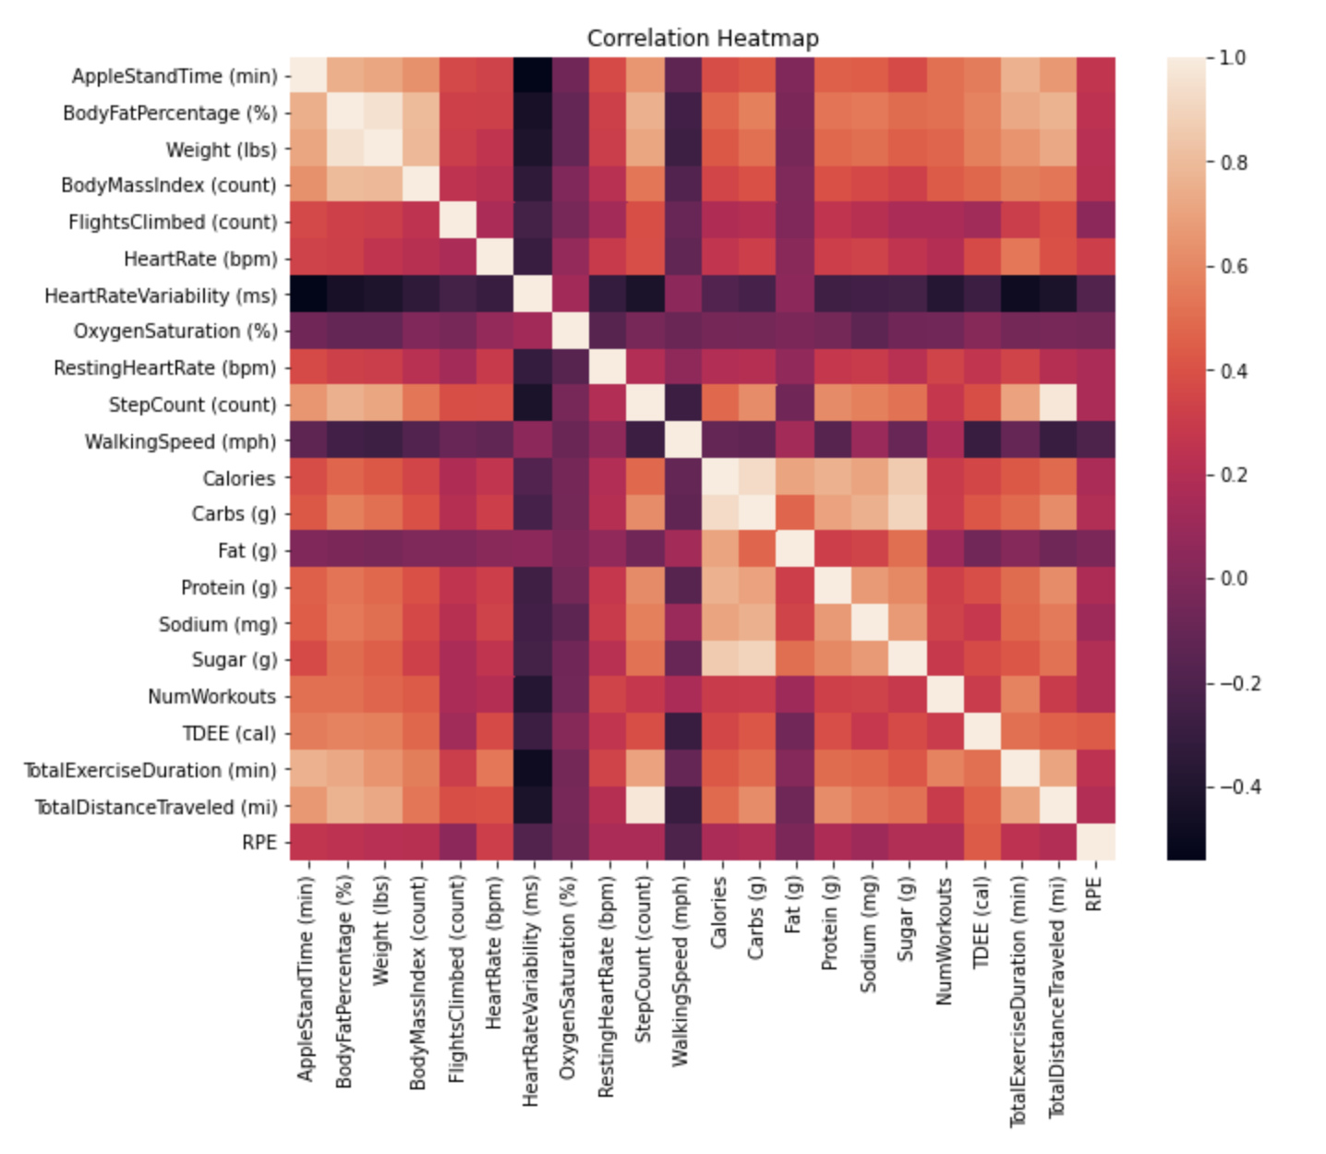
correlations
Notes:
We can also take a look at this heatmap to see how variables are related. As you can probably see, there does seem to be multicollinearity between mant of the predictors. We will deal w/ this issue when constructing some of our models.

Slide 15
analysis
Notes:
Now lets dive futher into the analysis and research questions.

Slide 16

research questions
What is my body fat percentage?
How much food should I eat each day to maintain my current physique?
If It Fits Your Macros (IIFYM) or Counting Calories?
Notes:
There were 3 main questions I was curious to study from this dataset. Whhat is my BF %, ….

Slide 17
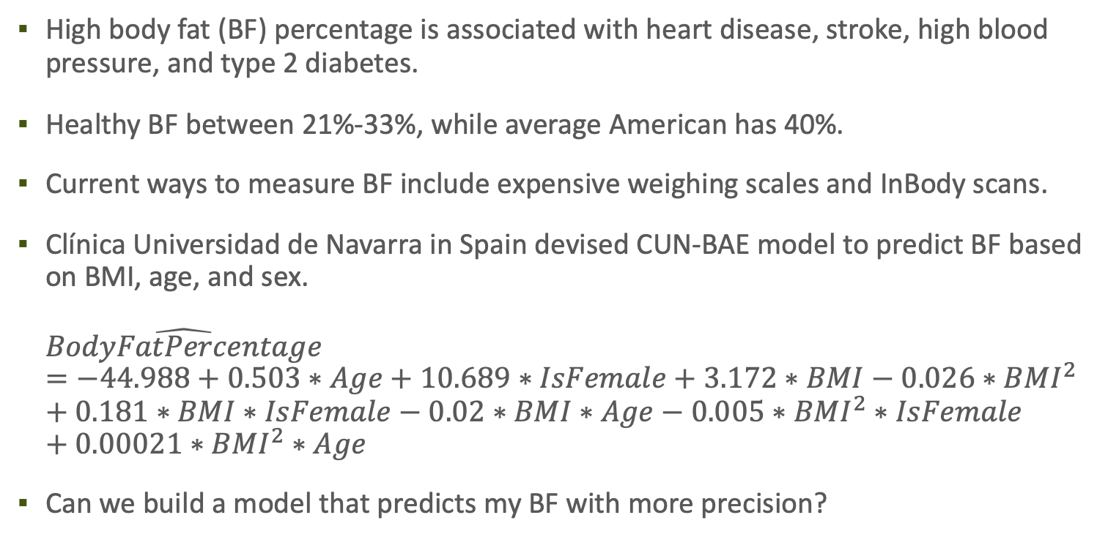
What is my body fat percentage?
High body fat (BF) percentage is associated with heart disease, stroke, high blood pressure, and type 2 diabetes.
Healthy BF between 21%-33%, while average American has 40%.
Current ways to measure BF include expensive weighing scales and InBody scans.
Clínica Universidad de Navarra in Spain devised CUN-BAE model to predict BF based on BMI, age, and sex. $\hat{BodyFatPercentage}=−44.988+0.503∗Age+10.689∗IsFemale+3.172∗BMI−0.026∗BMI^{2}+0.181∗BMI∗IsFemale−0.02∗BMI∗Age−0.005∗BMI^{2}∗IsFemale+0.00021∗BMI^{2}∗Age$
Can we build a model that predicts my BF with more precision?
Notes:
Lets start by studying the first research question.

Slide 18
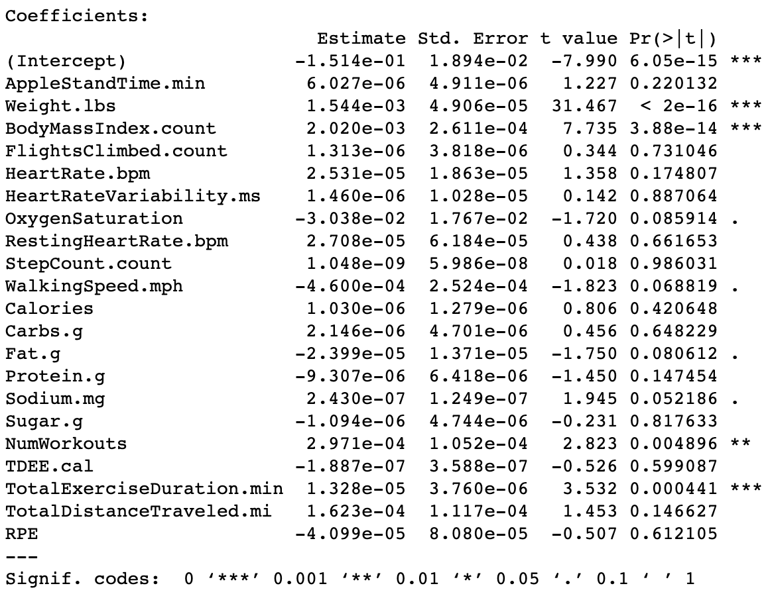
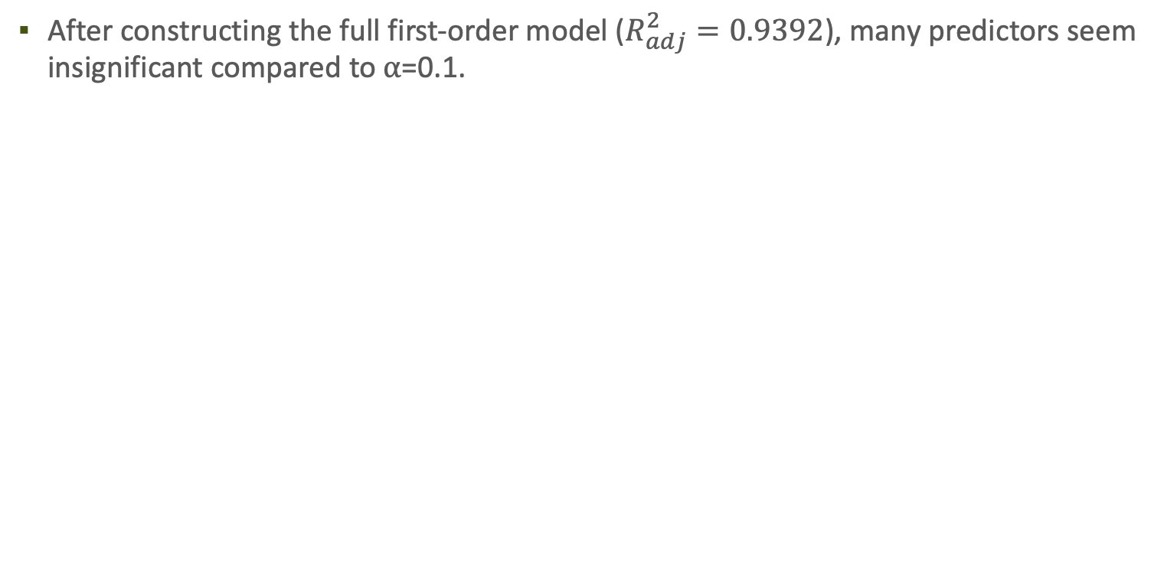
Model 1: Full first-order model
After constructing the full first-order model ($R_{adj}^{2}=0.9392$), many predictors seem insignificant compared to ⍺=0.1.
Notes:
I began by constructing a full first oder model. Right off the bat, I saw that many predictors seemed insignifacnt with low p values compared to alpha=0.1. This original model, however, does explain ~94% of the variation in body fat which is quite high, but we will still explore some other models.

Slide 19
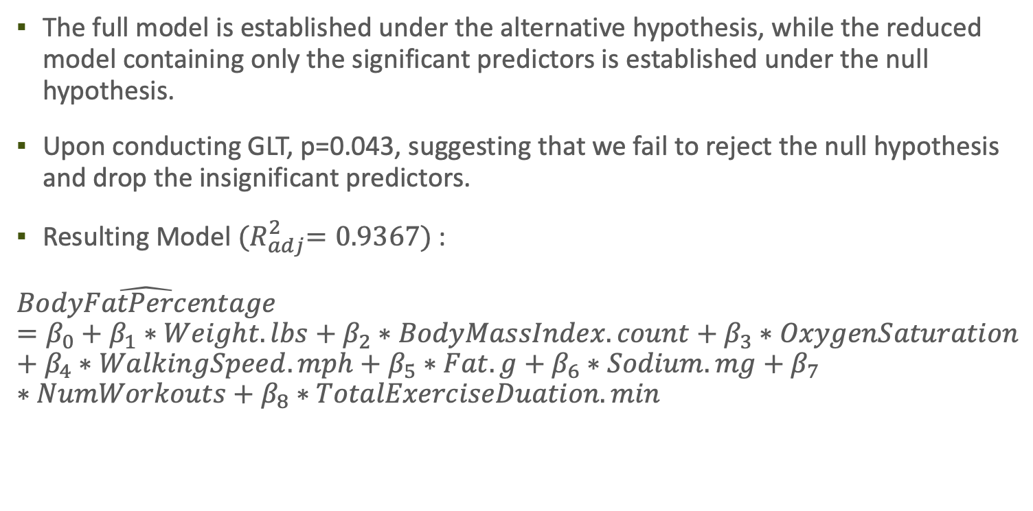
Model 2: reduced model
The full model is established under the alternative hypothesis, while the reduced model containing only the significant predictors is established under the null hypothesis.
Upon conducting GLT, p=0.043, suggesting that we fail to reject the null hypothesis and drop the insignificant predictors.
Resulting Model ${(R}_{adj}^{2}=0.9367)$:
$$\hat{BodyFatPercentage}=β_{0}+β_{1}∗Weight.lbs+β_{2}∗BodyMassIndex.count+β_{3}∗OxygenSaturation+β_{4}∗WalkingSpeed.mph+β_{5}∗Fat.g+β_{6}∗Sodium.mg+β_{7}∗NumWorkouts+β_{8}∗TotalExerciseDuation.min$$
Notes:
I proceeded by conducting the GLT to see if these insignificant predictors could be dropped. the null hypothesis involved the reduced model with the predicotrs dropped, while the alternative hypothesis involved the full model. With a p value less than alpha, I concluded that the predictors could be dropped. As you can see the resulting model is presented here and has a slightly lower r^2 of 0.9367.

Slide 20
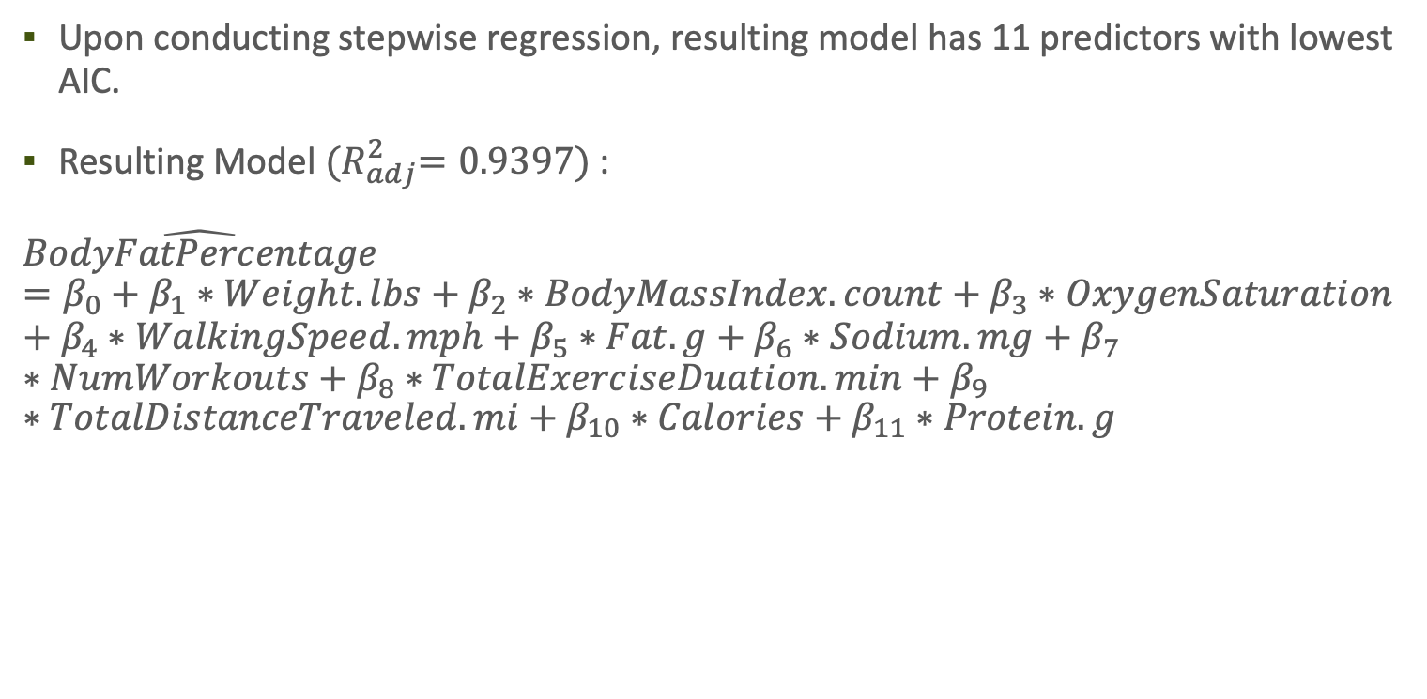
Model 3: stepwise regression
Upon conducting stepwise regression, resulting model has 11 predictors with lowest AIC.
Resulting Model ${(R}_{adj}^{2}=0.9397)$:
$$\hat{BodyFatPercentage}=β_{0}+β_{1}∗Weight.lbs+β_{2}∗BodyMassIndex.count+β_{3}∗OxygenSaturation+β_{4}∗WalkingSpeed.mph+β_{5}∗Fat.g+β_{6}∗Sodium.mg+β_{7}∗NumWorkouts+β_{8}∗TotalExerciseDuation.min+β_{9}∗TotalDistanceTraveled.mi+β_{10}∗Calories+β_{11}∗Protein.g$$
Notes:
Next, I wanted to build a thurd model using stepwise model selection. It took 9 iterations for the AIC to converge, but here is the resulting model.

Slide 21
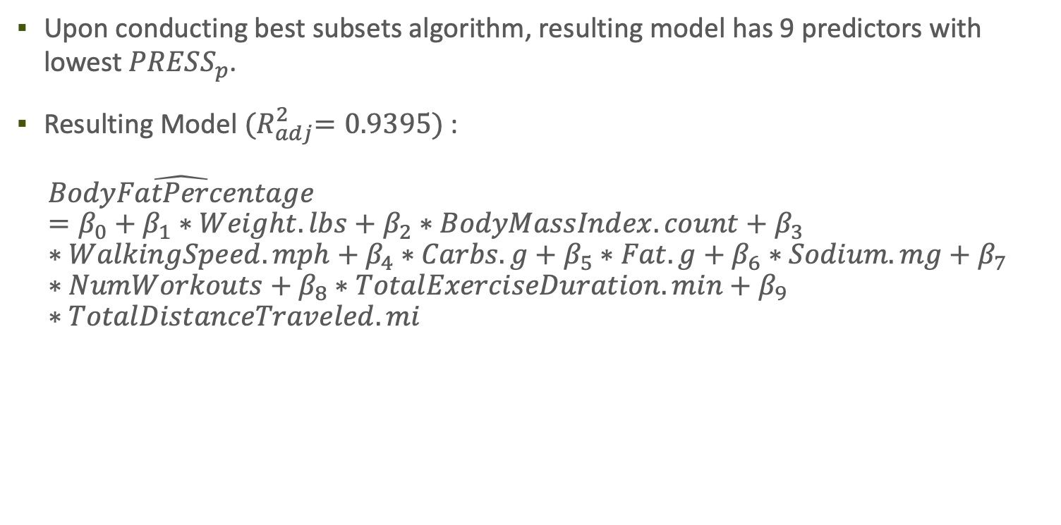
Model 4: Best subsets
Upon conducting best subsets algorithm, resulting model has 9 predictors with lowest $PRESS_{p}$.
Resulting Model ${(R}_{adj}^{2}=0.9395)$:
$$\hat{BodyFatPercentage}=β_{0}+β_{1}∗Weight.lbs+β_{2}∗BodyMassIndex.count+β_{3}∗WalkingSpeed.mph+β_{4}∗Carbs.g+β_{5}∗Fat.g+β_{6}∗Sodium.mg+β_{7}∗NumWorkouts+β_{8}∗TotalExerciseDuration.min+β_{9}∗TotalDistanceTraveled.mi$$
Notes:
Lastly, I wanted to construct a model using the best subsets algorithm. I chose the model with the lowest press_p, since prediction is the ultimate goal of this research question. The resulting model had 9 predictors.

Slide 22
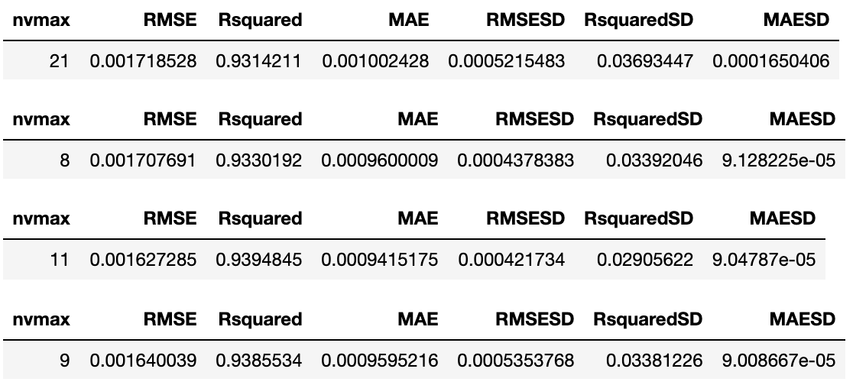
evaluation
5-Fold CV
Notes:
To evaluate these models, I proceed with 5-fold cross validation and the third model obtained from stepwise regression is what I sleected. It has the lowest rmse and highest r^2.

Slide 23
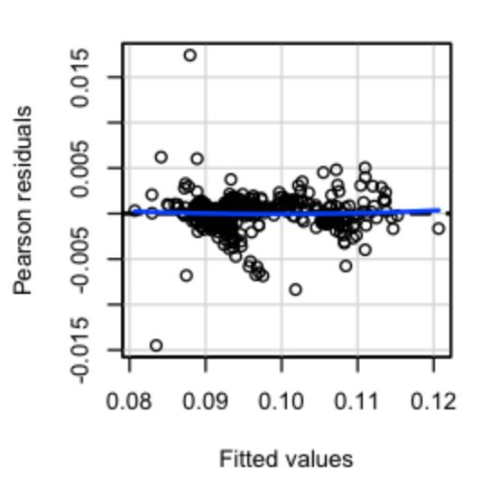
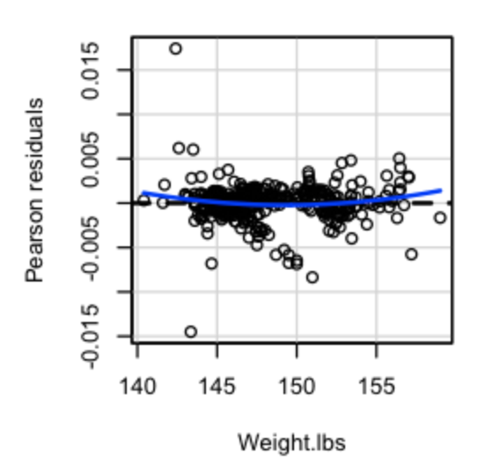
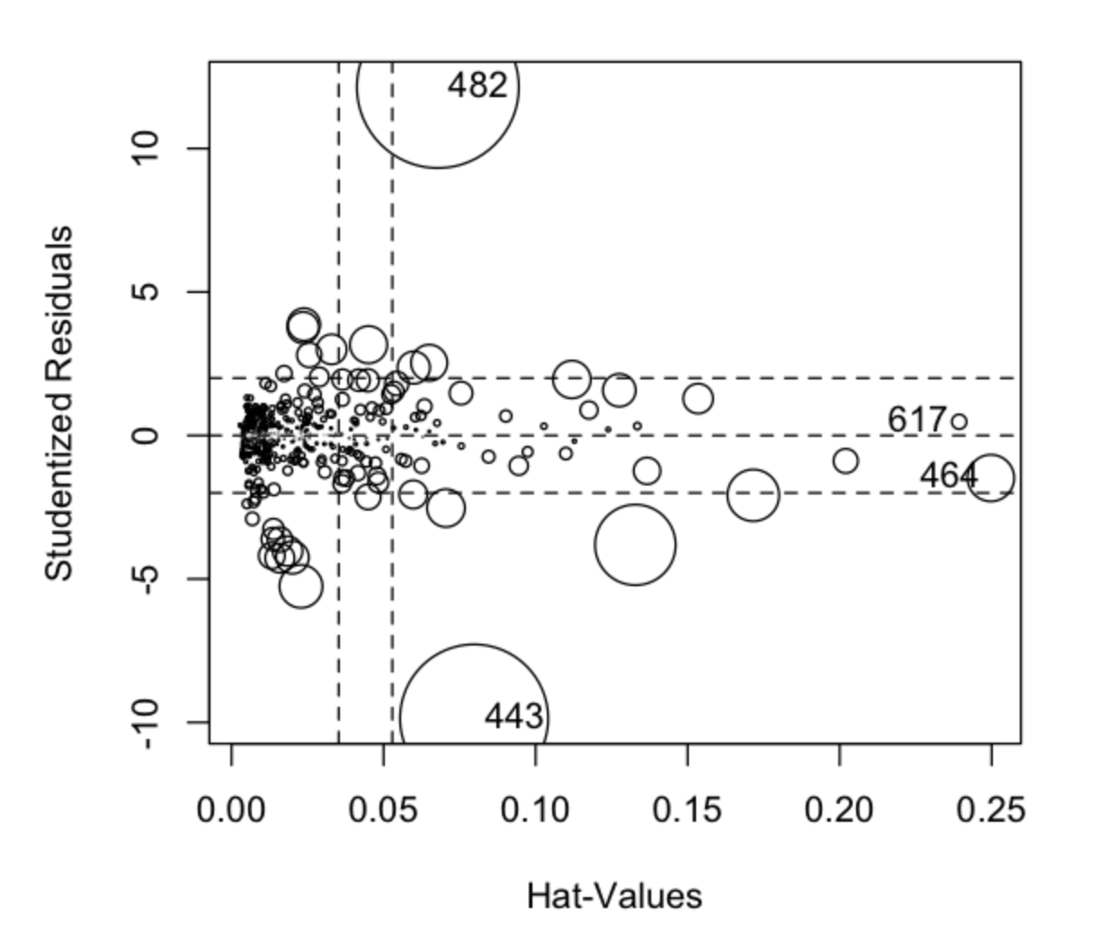
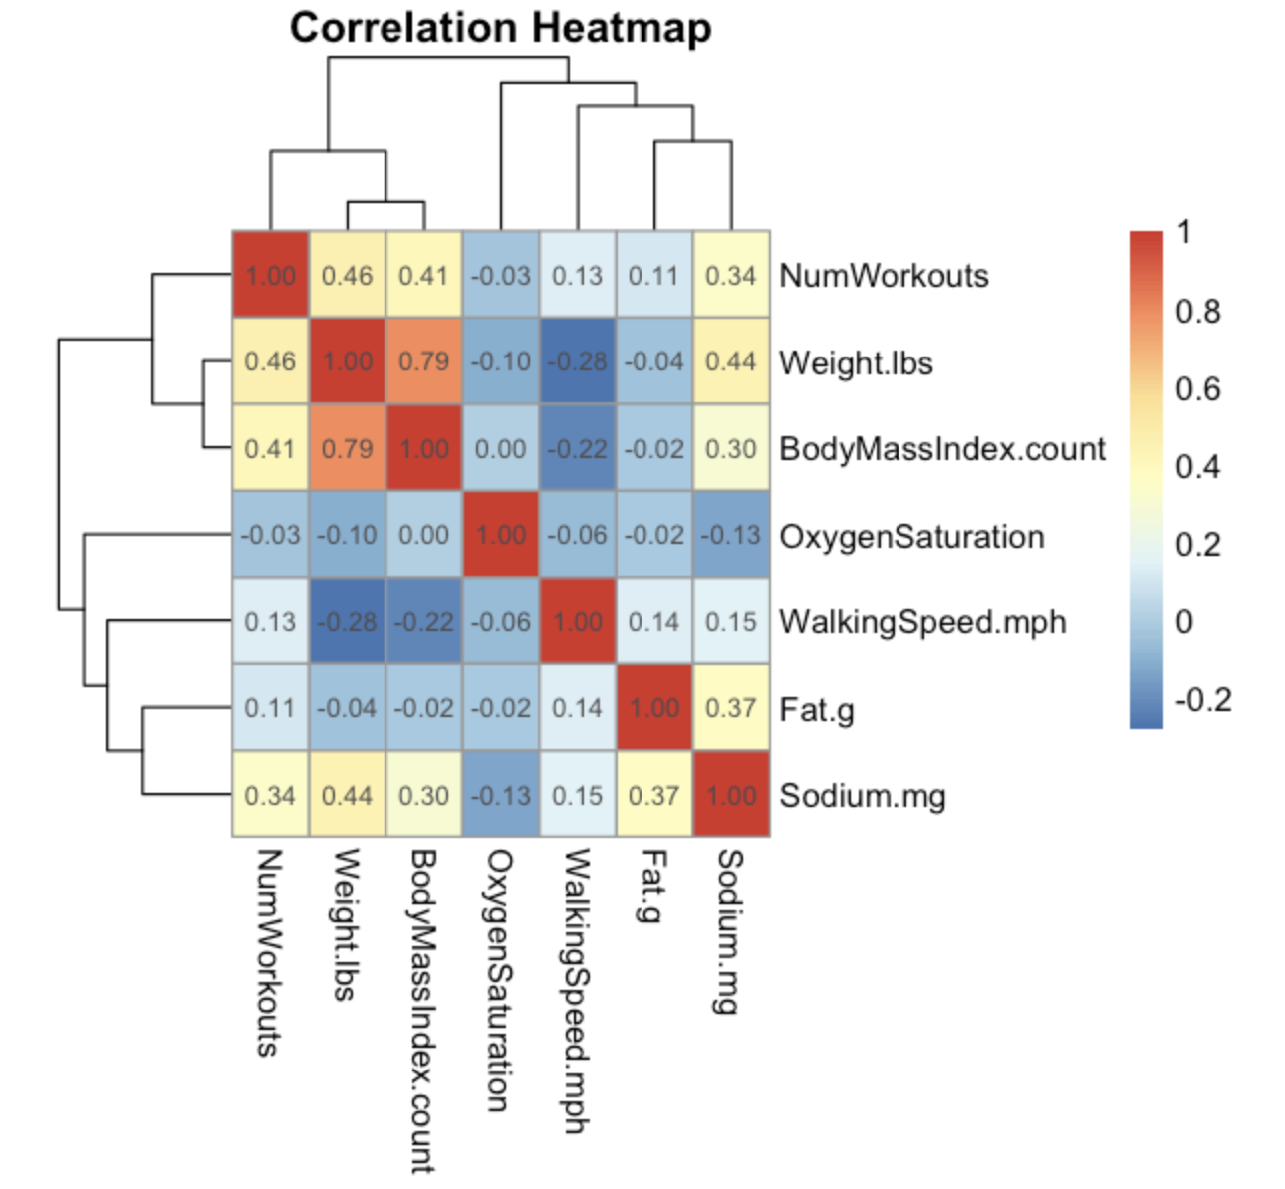
Diagnostics
BF tests indicate non-constant variance for several predictors.
Shapiro test (p = 0) indicates non-normality of residuals.
4 clear influential points by evaluating Cook’s distances.
Multicollinearity between Weight and BMI suggests adding interaction term.
Notes:
After obtaining this final model, I performed diagnoistics which included checking for constant vcaraince, normality of residuals, influential points, and multiclollinearity. Many of the residuals plots and shapiro test indicated non-constant caraince and non-normality of residuals. There were also 4 influential points by considering cooks distances. And multicollinearity definitely seems to exists between weight and BMI.

Slide 24
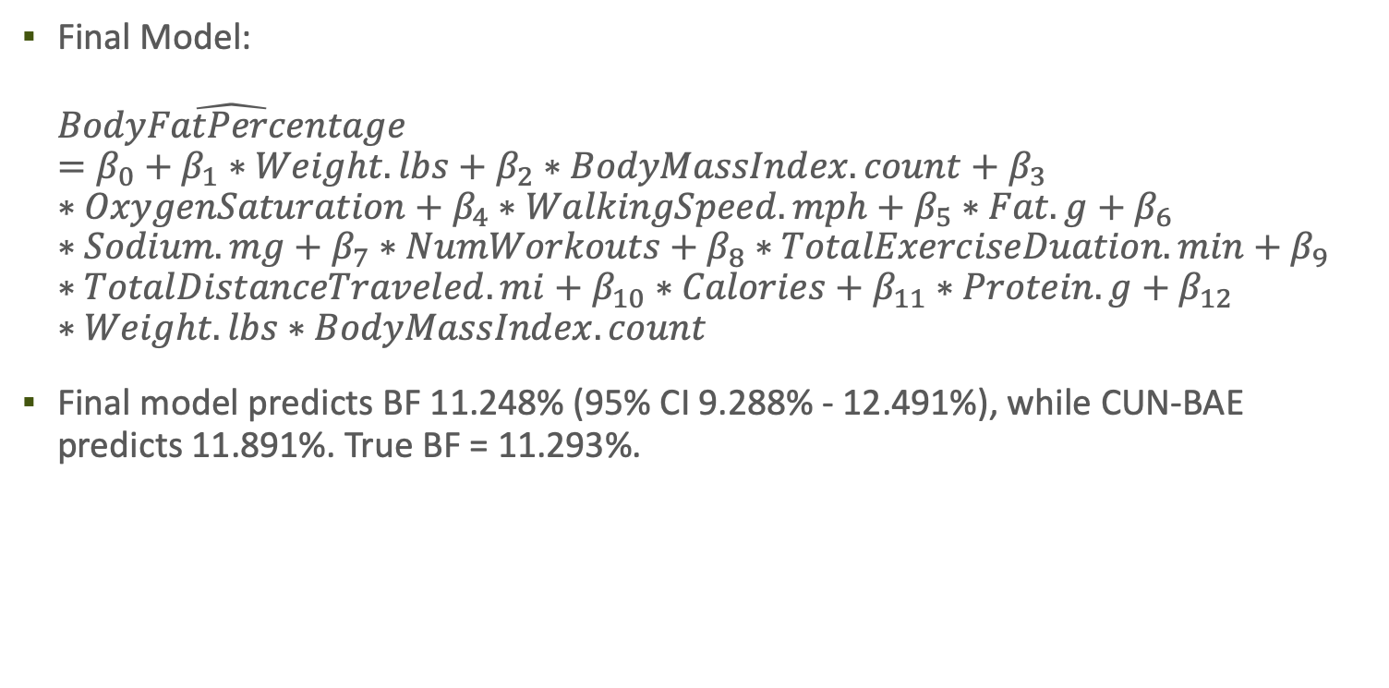
prediction
Final Model: $\hat{BodyFatPercentage}=β_{0}+β_{1}∗Weight.lbs+β_{2}∗BodyMassIndex.count+β_{3}∗OxygenSaturation+β_{4}∗WalkingSpeed.mph+β_{5}∗Fat.g+β_{6}∗Sodium.mg+β_{7}∗NumWorkouts+β_{8}∗TotalExerciseDuation.min+β_{9}∗TotalDistanceTraveled.mi+β_{10}∗Calories+β_{11}∗Protein.g+β_{12}∗Weight.lbs∗BodyMassIndex.count$
Final model predicts BF 11.248% (95% CI 9.288% - 12.491%), while CUN-BAE predicts 11.891%. True BF = 11.293%.
Notes:
The final model was constructed by performing WLS regression to correct non-constant varaicne and non-normality of residuals. The 4 influential points were also dropped which is ok, since the dataset num records is greater than 10 times num parameters. And an interaction term was added between the correlated predictors. This final model predicts my BF to be 11.25% while the cunbae model predicted 11.89%. As of last week, my true body fat when I measured it was 11.29.

Slide 25
conclusion
CUN-BAE equation more generalizable, while this model is more fit to my data.
No access for PI & CI for CUN-BAE model.
My weighing scale could have measurement errors, reporting inaccurate BF.
Notes:
This final model seems to predict better than the cunbae model as we saw on the last slide. However, there could still be some potential issues. The cunbae model is definieitley more generalizable. The university in spain used a much larger dataset with more people. This model I have constructed is fit only to my data.
Precisely Comparing the cunbae model with my model is also difficult since we don’t have access to pi and ci for the cunbae model.
Lastly, my weighing scale that reports BF could have some measurement errors and may report inaccurate bf.
Despite these issues, this model can still be used to give me a rough idea of my BF which can be really useful when im somewhere with a weighing scale that doesn’t report body fat.

Slide 26
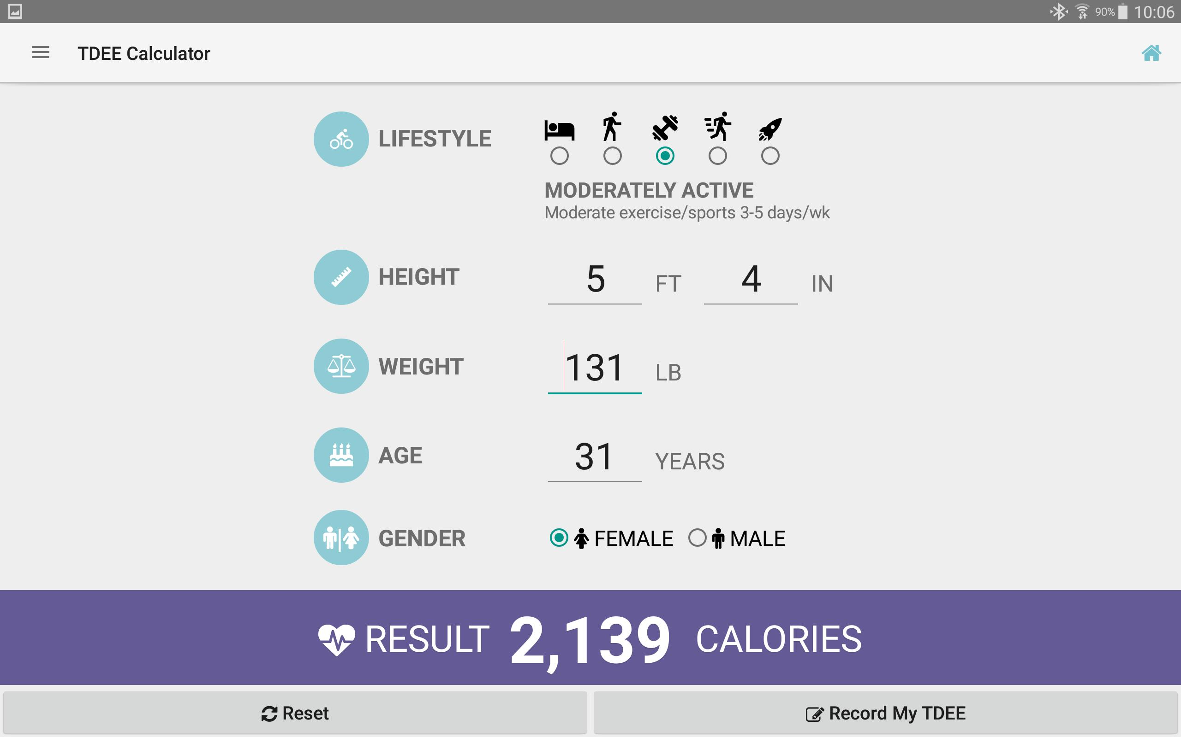
How much food should I eat daily to maintain current physique?
Eating at Total Daily Energy Expenditure (TDEE) ensures weight maintenance.
Generic TDEE calculators online based on generic features: age, gender, weight, activity level (scale 1-5), and BF.
Research papers suggest TDEE is based on additional factors, including heart rate, exercise duration, number of workouts, and RPE.
Notes:
The next research question I wanted to study was how much food should I ….
In order to mainitain your weight, you should be eating at your total daily energy expenditure or TDEE, which is how many calories u burn/day.
There are many online calculators such as this one that report TDEE from very generic features.
Some research papers indicate that tdee can be more precisely estimated using more factors like heart rate, exercise duration, numworkouts, and rpe. So we will try to build a model that is better than these online calcs.

Slide 27
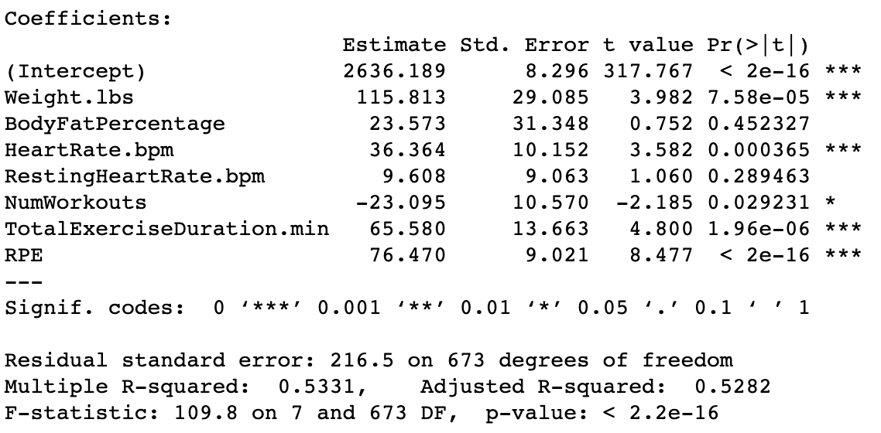
Model 1: first-order model
First order model constructed with predictors in online TDEE calculators and those suggested by research papers.
Notes:
I first began by constructing a first-order model by using predictors used int hese online tdee calcs and those suggested by the numerous research papers I reviewed.

Slide 28
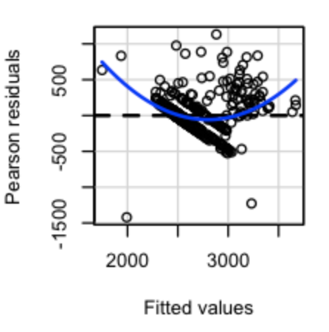
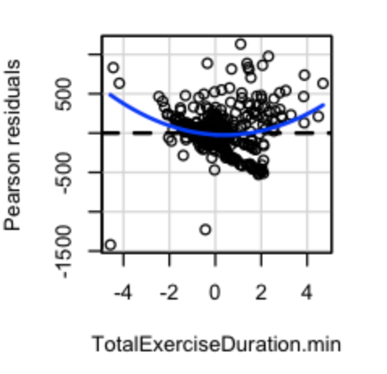
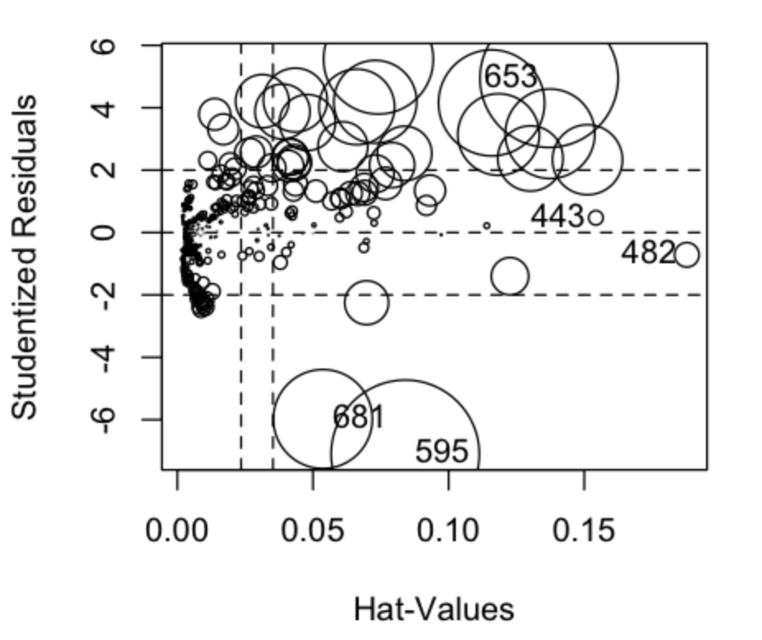
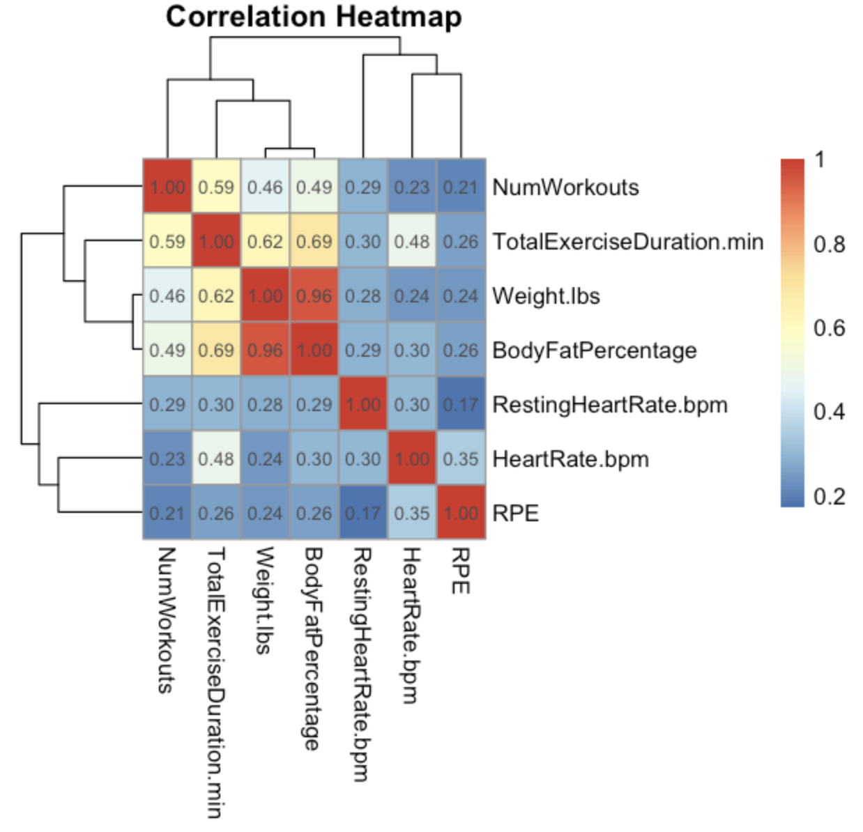
Diagnostics
BF tests indicate non-constant variance for several predictors.
Shapiro test (p = 0) indicates non-normality of residuals.
5 clear influential points by evaluating Cook’s distances.
Multicollinearity between Weight and BodyFatPercentage suggests adding interaction term.
Notes:
Next, I performed diagnoistics on the model and saw that the brown forsythe tests indicated non-constant carianve, the shapiro tests indicated non-normality of resids, the cooks distances suggested that 5 pts were influential, and multicollinearity existsed between weight and bf%.

Slide 29
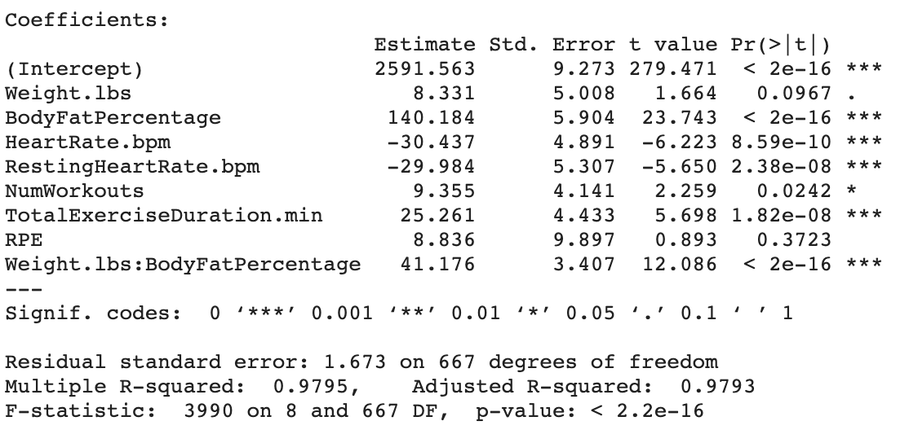
Model 2: WLS Regression
WLS regression model to correct non-constant variance and non-normality of residuals.
Notes:
To correct these violations, I built a model w/ WLS regression.

Slide 30
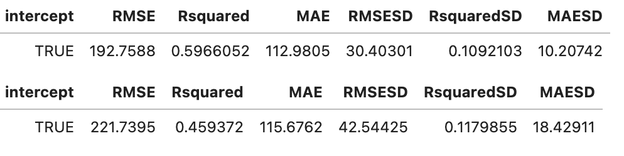
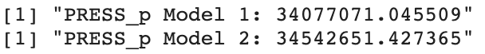
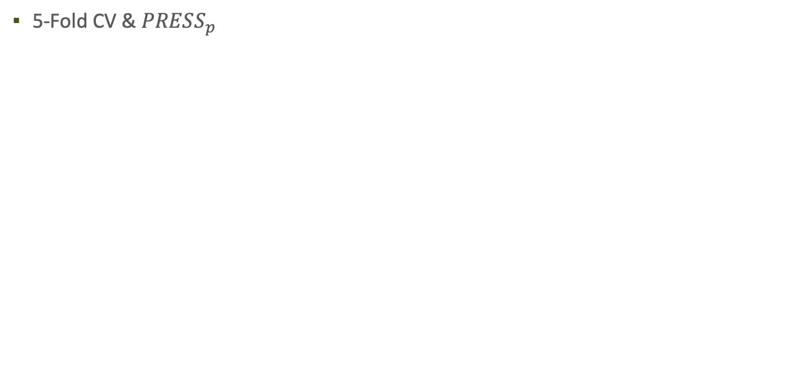
evaluation
5-Fold CV & $PRESS_{p}$
Notes:
Upon performing cross validation and looking at press values, it is clear that the first OLS model is better, despite some assumptions being violated.

Slide 31
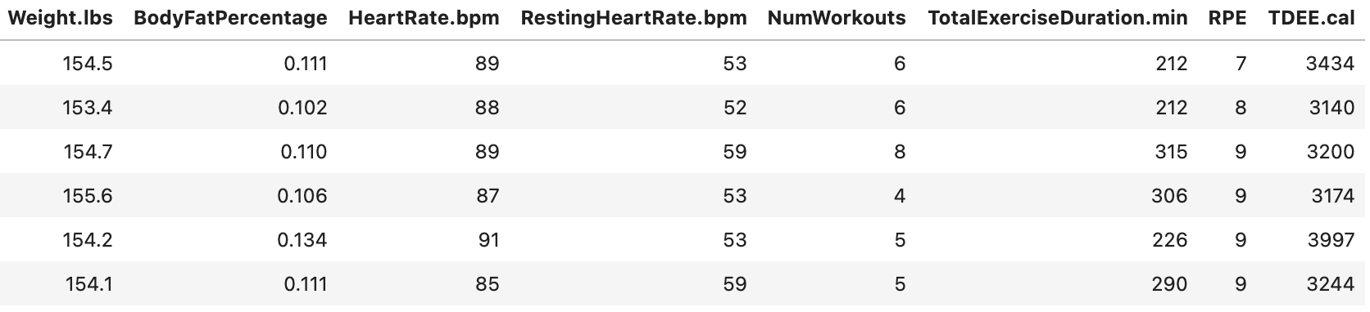
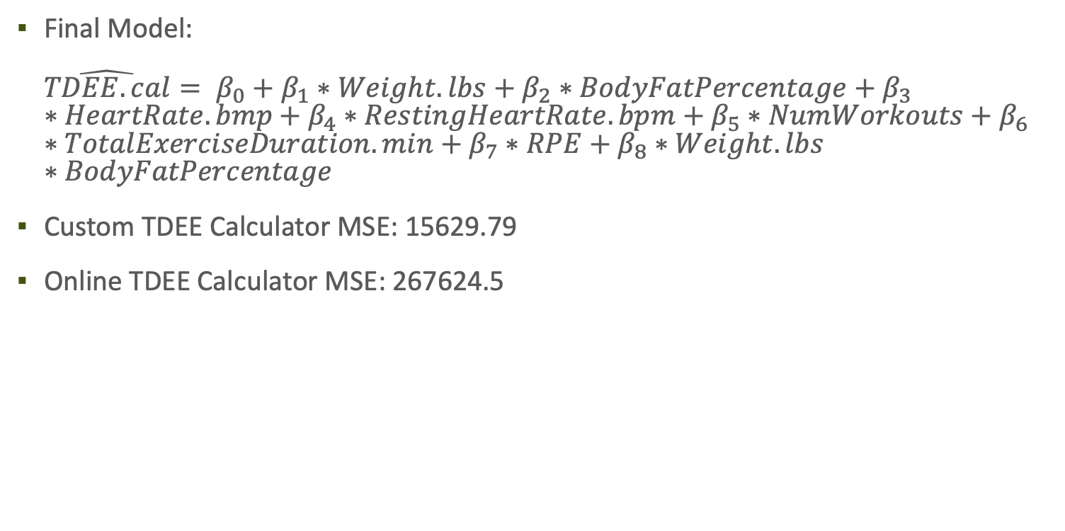
prediction
Final Model: ${\hat{TDEE.cal}= β}_{0}+β_{1}∗Weight.lbs+β_{2}∗BodyFatPercentage+β_{3}∗HeartRate.bmp+β_{4}∗RestingHeartRate.bpm+β_{5}∗NumWorkouts+β_{6}∗TotalExerciseDuration.min+β_{7}∗RPE+β_{8}∗Weight.lbs∗BodyFatPercentage$
Custom TDEE Calculator MSE: 15629.79
Online TDEE Calculator MSE: 267624.5
Notes:
The final model I decided to use was the OLS model. This table u can see has 5 records of new data that I recorded last wk. when I compared the results of the online calc to my custom calc using this model, the mse of my calc is much lower.

Slide 32
conclusion
TDEE in training data may be inaccurate, as Apple uses their own model to compute.
Not generalizable to public; fit to my data.
Small dataset, considering that body undergoes changes throughout years and decades. Calculator may be reliable now, but not in future if I change my fitness goals and/or reduce my commitment.
Notes:
Ultimately, this seems to be a pretty good model that provides a decent estimate of my TDEE. Some potential issues include that the TDEE in the training data may be inaccurate since apple probably uses their own model to compute it. This custom tdee calc is also prolyl not generalizable to the public since its fit to my data. The dataset to fit the model is also small considering that the body undergoes changes throughout years and decades. This calculator may be reliable now, but maybe not in the future if I change my fitness goals or reduce how much I commit to it. Nonetheless, this custom calc can still be used with other online calcualtors and reports to give me a baseline of how much I should eat.

Slide 33
IIFYM or counting calories?
Controversial whether one should count macros or calories.
If there is a reliable model to predict calories from macros, it wouldn’t make a difference. They will be equivalent.
Medical journals suggest foods with high carbs have high fat and foods with high protein have low fat.
Notes:
Many athletes debate whether they should follow an ”if it fits your macros” diet or simply count calories. I want to study whether it actually makes a differenece when it comes to achieveing fitness goals. If I can build a reliable model to predict calories from macros, it would be equivalent to track macros or calories. After reading a few medical journals, I also came to learn that foods w/ high carbs typically have high fat and foods with high protein have low fat. This multicollinearity will play a role when we build models.

Slide 34
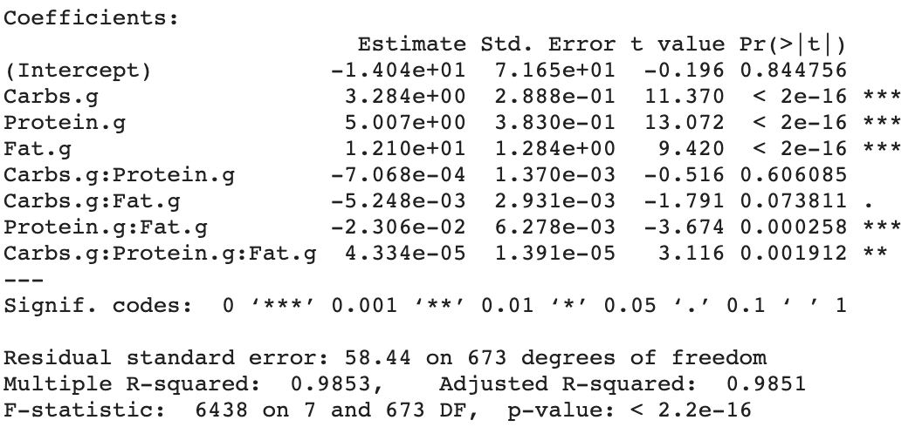
Model 1: Full second-order model
Second order model constructed due to medical journals suggesting multicollinearity between predictors.
Notes:
I started off by building a full second order model due to the medical jounrals I read suggesting that there is multicollinearity between the predictors.

Slide 35
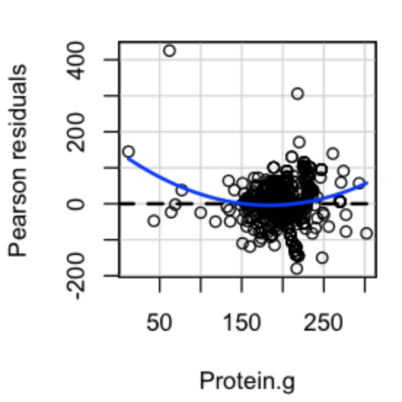
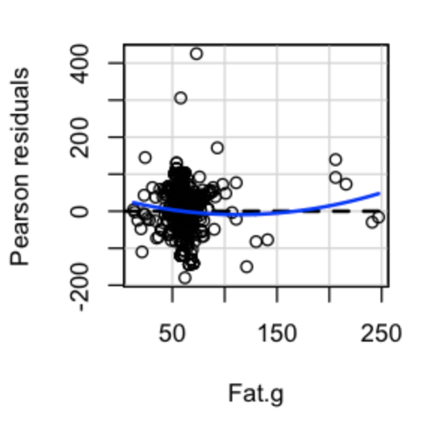
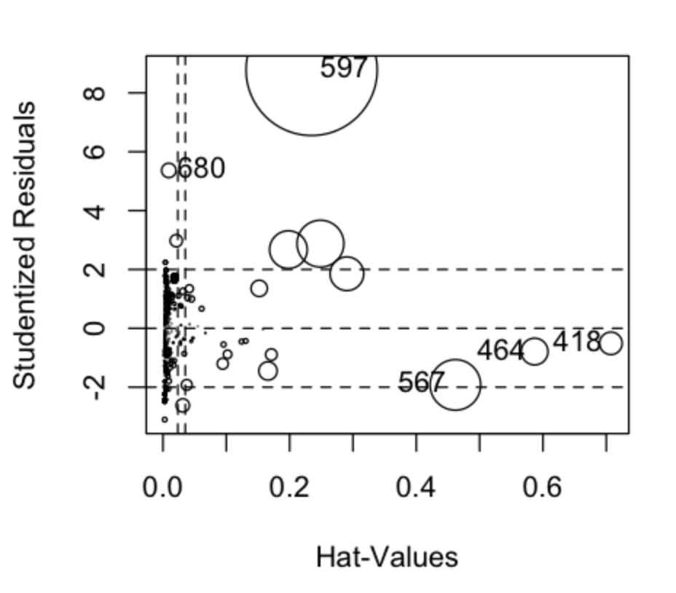
Diagnostics
BF tests indicate non-constant variance for several predictors.
Shapiro test (p = 0) indicates non-normality of residuals.
5 clear influential points by evaluating Cook’s distances.
Notes:
Next, I performed diagnoistics to check if any MLR assumptions were violated. Some residual plots and brown forsythe tests indicated non-consant variance, the shapiro test suggested that residuals were not normally distributed, and upon evaluation of cooks distances, I identified 5 influential points.

Slide 36
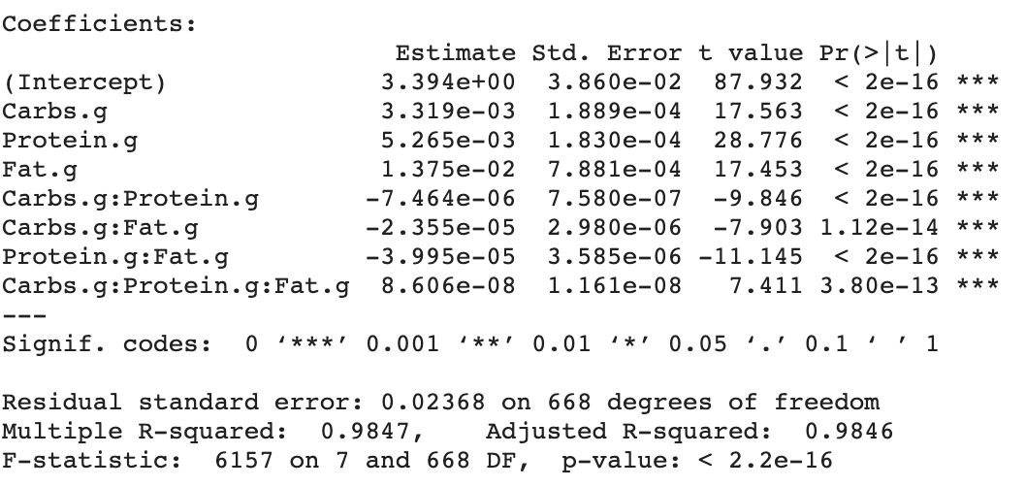
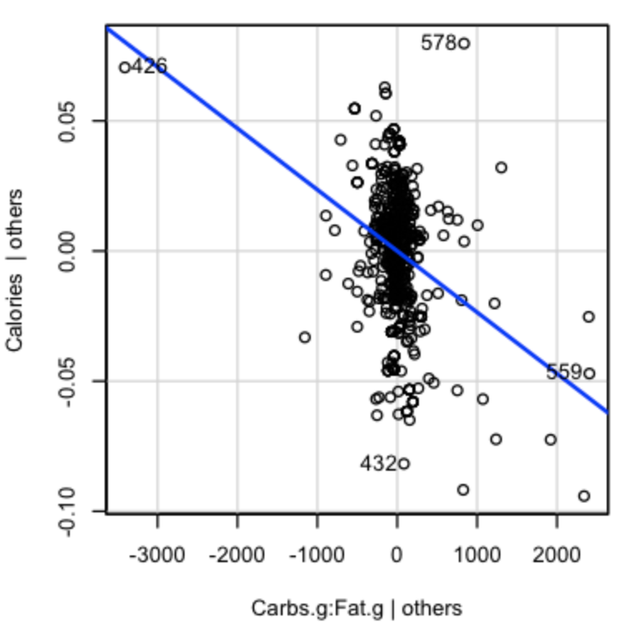
Model 2: OLS w/ Y transformed
Model with Y transformed (using Boxcox method) to correct non-constant variance and non-normality of residuals.
AV plots suggest all predictors add value to model.
Notes:
To correct these violations, I started by using the boxcox method to transform y. I also looked at the av plots of this transformed model to verify that all the predictors add some value to the model. All plots had non-zero slopes which confirmed this.

Slide 37
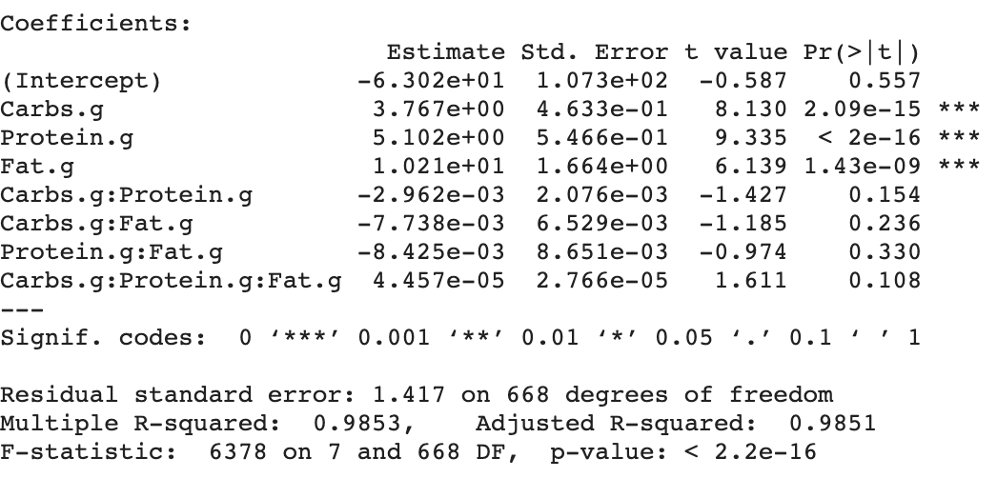
Model 3: WLS Regression
WLS regression model to correct non-constant variance and non-normality of residuals.
Notes:
As another attempt to correct assumptions violations, I went about constructing a WLS regression model.

Slide 38
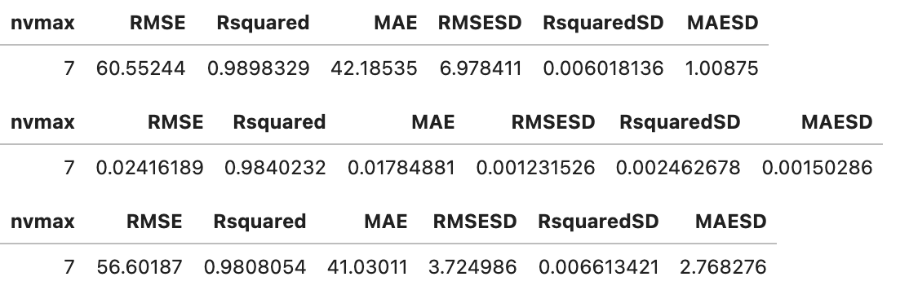
evaluation
5-Fold CV
Notes:
After constructing 3 models, I applied cv to compare them. I decided to choose the model 1, which was the OLS model, as it had the highest r^2 and lowest press value.

Slide 39
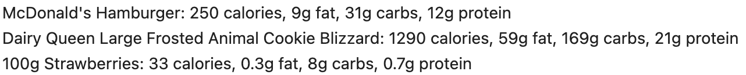
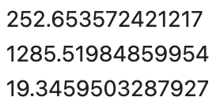

prediction
Final Model: OLS $\hat{Calories}=β_{0}+β_{1}∗Carbs.g+β_{2}∗Fat.g+β_{3}∗Protein.g+β_{4}∗Carbs.g∗Fat.g+β_{5}∗Carbs.g∗Protein.g+β_{6}∗Fat.g∗Protein.g+β_{7}∗Carbs.g∗Fat.g∗Protein.g$
Notes:
As u can see the final model relies on carbs, fat, protein, and their interactions to predict calories. I identified 3 common food items, a mcd hamb, dairy q blizzar, and 100g of strawberries, to see how the model performed. As we can see on the right, the predictions seem quite close to the true caloric amounts. I also compared these predictions to the predcitions of the other models, and noticed that this model had the lowest mse.

Slide 40
conclusion
Doesn’t make a difference to track macros vs. calories.
Nutrition labels vary depending on the source. Some claim 100g of strawberries has 33 calories, while others claim it may have 40. These discrepancies can make model evaluation difficult and unrealizable.
Notes:
Ultiamtely, using our final model, we can see that it doesn’t really make a difference if we measure calories or macronutrients. However, one major issue to this question is that nutrition labels often vary depending on the source. ….
Anyhow, at the end of the day this model still gives us a good baseline.

Slide 41
Appendix

Slide 42




Distributions

Slide 43



Distributions

Slide 44


Distributions

Slide 45



Distributions

Slide 46



Distributions

Slide 47



Distributions

